Slide 1
Agenda Cisco Data Virtualization PDTool Training Multi-Tenant Configuration
Notes:
Hello, and welcome to the PDTool Training course for Cisco Information Server, or CIS.

Slide 2
Topics
PDTool VCS Multi-Tenant
Notes:
We begin this module by examining the VCS multi-tenant capabilties.

Slide 3
PDTool License
(c) 2014 Cisco and/or its affiliates. All rights reserved.
This software is released under the Eclipse Public License. The details can be found in the file LICENSE. Any dependent libraries supplied by third parties are provided under their own open source licenses as described in their own LICENSE files, generally named .LICENSE.txt. The libraries supplied by Cisco as part of the Composite Information Server/Cisco Data Virtualization Server, particularly csadmin-XXXX.jar, csarchive-XXXX.jar, csbase-XXXX.jar, csclient-XXXX.jar, cscommon-XXXX.jar, csext-XXXX.jar, csjdbc-XXXX.jar, csserverutil-XXXX.jar, csserver-XXXX.jar, cswebapi-XXXX.jar, and customproc-XXXX.jar (where -XXXX is an optional version number) are provided as a convenience, but are covered under the licensing for the Composite Information Server/Cisco Data Virtualization Server. They cannot be used in any way except through a valid license for that product.
This software is released AS-IS!. Support for this software is not covered by standard maintenance agreements with Cisco. Any support for this software by Cisco would be covered by paid consulting agreements, and would be billable work.

Slide 4
Version Control for Multi-Tenants
A multi-tenant environment contains multiple groups or organizations sharing the Cisco Information Server infrastructure.
Notes:
Next, let’s examine some common deployment options for CIS.

Slide 5
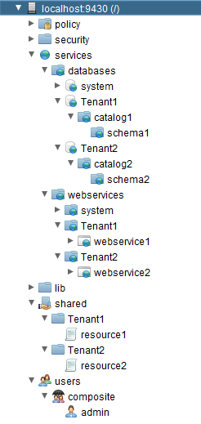




Multi-Tenant VCS Topology
Multi-Tenant VCS Topology
CIS Studio Resource Definition
Read
Write
CIS Studio (Tenant1)
CIS Studio Resource Definition
Read
Write
Check In
CIS Repository
CIS Studio (Tenant 2)
Check Out
VCS Repository
CIS Studio Resource Definition
Read
Write
CIS Studio (Tenant 3)

Slide 6
Version Control with Multi-Tenants
Requirement
Need to configure VCS integration for a single tenant and not the entire Composite repository.
How PDTool works with Version Control
VCS integration is configured at the Composite Server level.
All Composite base folders must get checked in.
Invalid results will occur if intermediate folders are not checked in.
The initial check-in must be done at Composite root folder “/” of the Composite repository.
This insures that all required folders get checked in.

Slide 7
Multi-Tenant VCS Strategy – Automated
Strategy – Automated
PDTool – use “vcsInitializeBaseFolderCheckin” in a deployment plan
PDToolStudio – use ExecutePDToolStudio.bat -vcsinitBaseFolders [-customCisPathList custom-CIS-path-list] [-vcsuser vcs-username] [-vcspassword vcs-password]
1
Prepare VCS Repository (admin)
Install
PD Tool or PDToolStudio
2
3
Configure VCS Specific Environment Properties
4.2
Initialize VCS Base Folders (admin)
4.1
Initialize VCS Workspace

Slide 8
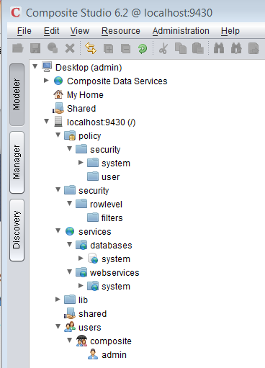
Composite Server Base-Level Folders
Base level folders (/)
/policy
/security
/user
/security
/rowlevel
/filters
/services
/databases
/services
/webservices
/shared
/system
/connector
/users
/composite
/admin
root.cmf
policy.cmf
security.cmf
user.cmf
security.cmf
rowlevel.cmf
filters.cmf
services.cmf
databases.cmf
services.cmf
webservices.cmf
shared.cmf
system.cmf
connector.cmf
users.cmf
composite.cmf
admin.cmf
Notes:
A new Composite instance contains only the base folders and no other objects.

Slide 9
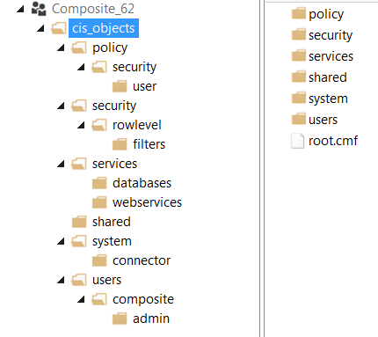
Admin Check-in Composite Server Base-Level Folders
Composite PDToolStudio: Check-in to VCS
ExecutePDToolStudio.bat -vcsinitBaseFolders -vcsuser user -vcspassword password
Base level folders (/)
/policy
/security
/user
/security
/rowlevel
/filters
/services
/databases
/services
/webservices
/shared
/system
/connector
/users
/composite
/admin
VCS: Checked in base-level structure

Slide 10
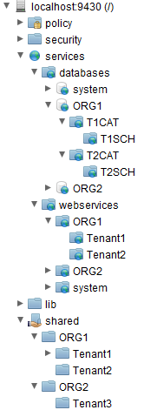
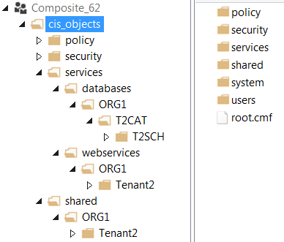
Admin Check-in Composite Server Custom CIS Folders
Composite PDToolStudio: Check-in to VCS
ExecutePDToolStudio.bat -vcsinitBaseFolders -customCisPathList “/services/databases/ORG1/T2CAT<TYPE=CATALOG>/T2SCH<TYPE=SCHEMA>, /services/webservices/ORG1/Tenant2, /shared/ORG1/Tenant2"
Custom CIS folders
VCS: Checked in custom folder structure
Database
Web Service
Shared

Slide 11
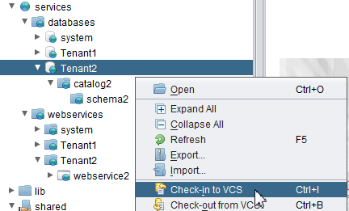
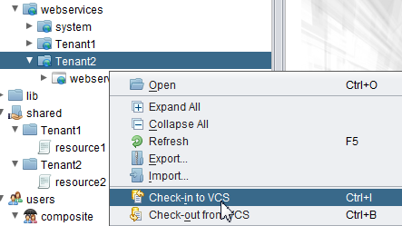
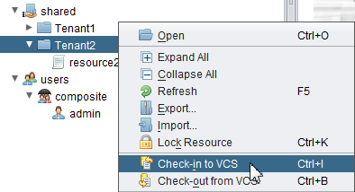
Multi-Tenant User2 Check-in from Studio
Composite Studio Resources
Check-in Tenant2 only

Slide 12
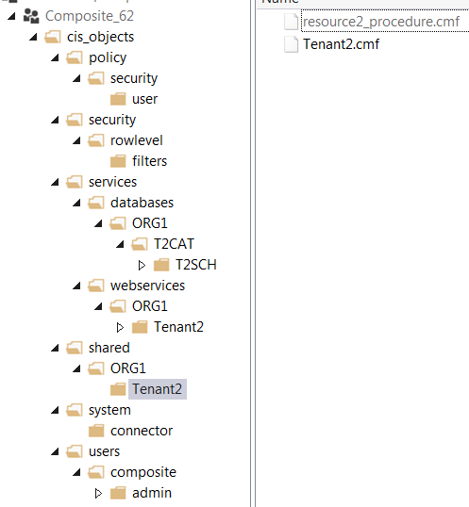
Multi-Tenant User2 Check-in Results
Composite Studio Resources
VCS Server: Results of Check-in
Studio resource2 is checked in as resource2_procedure.cmf
Folders are checked in as the foldername.cmf e.g. Tenant2.cmf
Tenant1 objects have not been checked in.
Tenant2 can manage their objects independent of Tenant 1

Slide 13
Additional Slides
Notes:
Next, let’s examine some common deployment options for CIS.

Slide 14
Additional Slides
Manual VCS Repository Creation

Slide 15
Multi-Tenant VCS Strategy – Manual
Strategy – manual using “new” CIS instance
Configure a new VCS repository for Composite.
Provide Composite folders …/Composite/cis_objects
Will need URL, Login Credentials
Configure PDTool Studio
Initialize the PDTool Studio workspace for the VCS repository.
Use URL and login credentials provided by customer
Create a new Composite server instance with no objects.
This is to establish the base-line folders.
Start Composite Studio and connect to the “new” CIS instance.
Configure “Options” – “Version Control System (VCS)”
Provide Workspace Folder
Provide PDTool Studio Script Folder
Check-in root “/” to establish base folders in VCS

Slide 16
Multi-Tenant VCS Strategy cont. – Manual
Strategy – “new” CIS instance
Handling Intermediate Folders prior to tenant folder.
The previous step discussed checking in at root “/”.
Scenario: Intermediate folders exist prior to tenant folders
/shared/folder1
/tenant1
/tenant2
/tenant3
Create “folder1” in the shared directory prior to checking in root “/”.
Check-in root “/”.
This insures that all intermediate folders and the .cmf files are accurately created. When the folder .cmf is not checked in, the check-out results cannot be guaranteed.

Slide 17
Multi-Tenant VCS Strategy cont. – Manual
Strategy – “existing” CIS instance
Restart Composite Studio PDTool to the existing multi-tenant server
Configure “Options” – “Version Control System (VCS)”
Use the same configuration settings that were used for the new CIS instance.
Provide Workspace Folder
Provide PDTool Studio Script Folder
Check-in specified tenant resources
/shared/tenant_x
/services/databases/tenant_x
/services/webservices/tenant_x
Best practice – all base folders must be checked
Note: If any intermediate folders between /shared and the tenant folders are not checked in during this process, the results of PDTool cannot be guaranteed.

Slide 18
Initialize a New Composite Server
Base level folders
/policy
/security
/user
/security
/rowlevel
/filters
/services
/databases
/services
/webservices
/shared
/system
/connector
/users
/composite
/admin
root.cmf
policy.cmf
security.cmf
user.cmf
security.cmf
rowlevel.cmf
filters.cmf
services.cmf
databases.cmf
services.cmf
webservices.cmf
shared.cmf
system.cmf
connector.cmf
users.cmf
composite.cmf
admin.cmf
Notes:
A new Composite instance contains only the base folders and no other objects.

Slide 19
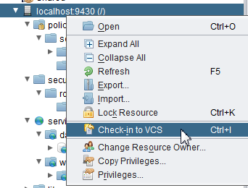
Check-in New Composite Server
Composite Studio: Check-in to VCS
Base level folders
/policy
/security
/user
/security
/rowlevel
/filters
/services
/databases
/services
/webservices
/shared
/system
/connector
/users
/composite
/admin
VCS: Checked in base-level structure

Slide 20
Check-in Existing Multi-Tenant Composite Server
Composite Studio Resources
Check-in Tenant2 only

Slide 21
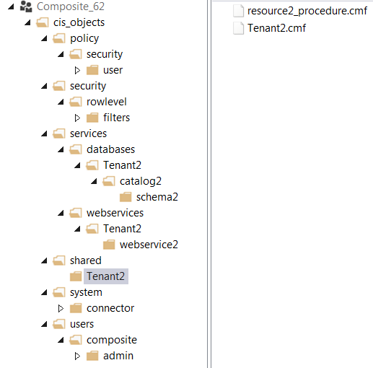
Multi-Tenant Check-in Results
Composite Studio Resources
VCS Server: Results of Check-in
Studio resource2 is checked in as resource2_procedure.cmf
Folders are checked in as the foldername.cmf e.g. Tenant2.cmf
Tenant1 objects have not been checked in.
Tenant2 can manage their objects independent of Tenant 1

Slide 22
Q&A

Slide 23

TOMORROW starts here.

